Slide 1
Concurrent Execution
Concurrency in
  Test Case
  Molecules
  Test Step
Notes:
Concurrent execution enables users to execute multiple test steps concurrently.
Concurrent execution can be applied to both the test cases and the molecules
If two or more different actions of a test case/molecule has the same step number, then these different steps would be executed concurrently by ZUG.

Slide 2

Test Case Concurrency
Test Case
  Concurrency achieved by using MVM or MVCV and GCE property.
  Test Case or Molecule is expanded for each combination of the MVMs or MVCV.
  Expanded Test cases or Molecules are then run Concurrently(parallel Execution).
Notes:
In this slide there is a test case
Considering the test case
Usually one action would be executed after another
In this case as there is a similar number mentioned on the step column for two of the actions , hence both the actions would be executed concurrently however different the actions may be.

Slide 3
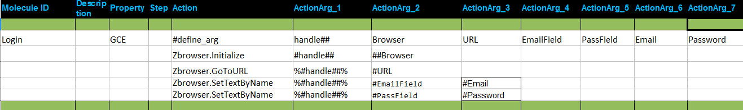
Molecule Concurrency
Molecule
Notes:
Considering the molecules
Usually one action would be executed after another
However in this case as there is a similar number mentioned on the step column for two of the actions , hence both the actions would be executed concurrently

Slide 4

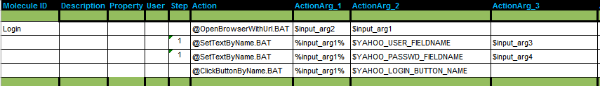
Example : Test Step Concurrency
Achieved by putting same number in the step field of the test steps
Test Case
Molecule

Slide 5

Thread Safe Context Variable
Different test cases or molecules running concurrently if create or update a context variable with the same name then there will be a conflict.
CHUR supports the notion of a thread specific instance of a context variable.
Responsibility of the Test Suite designer to create and use thread specific context variables
A ## (double hash) appended to the name of a context variable
Thread Safe Context variable

Slide 6
Exercise : Concurrent Execution
Write a test case to concurrently search in Google in different browser.

